Slide 1


HUMANOID ROBOTS (Reducing human risk in hazardous industries)
Allen Richards
Advanced machine learning – FINAL PROJECT

Slide 2

INTRODUCTION
Humanoid robots are machines designed to mimic human behavior.
Deep learning advancements enable robots to operate in real-world environments.
Focus: Replace humans in life-threatening tasks like mining, chemical plants, disaster recovery.
Goal: Reduce human fatalities and ensure worker safety.

Slide 3


LITERATURE REVIEW – PART I
Tesla’s Optimus robot aims to automate dangerous industrial tasks using AI vision.
Boston Dynamics' Atlas shows advanced mobility and obstacle navigation.
Both use deep reinforcement learning and computer vision technologies.
Focus: Replace humans in repetitive and hazardous roles.

Slide 4

LITERATURE REVIEW – PART II
DeepMind developed deep reinforcement learning for robotic locomotion.
Vision Transformers enhance robots' scene understanding and decision-making.
Robots now achieve better real-time perception in complex environments.
Future focus: Autonomous adaptability without human programming.

Slide 5

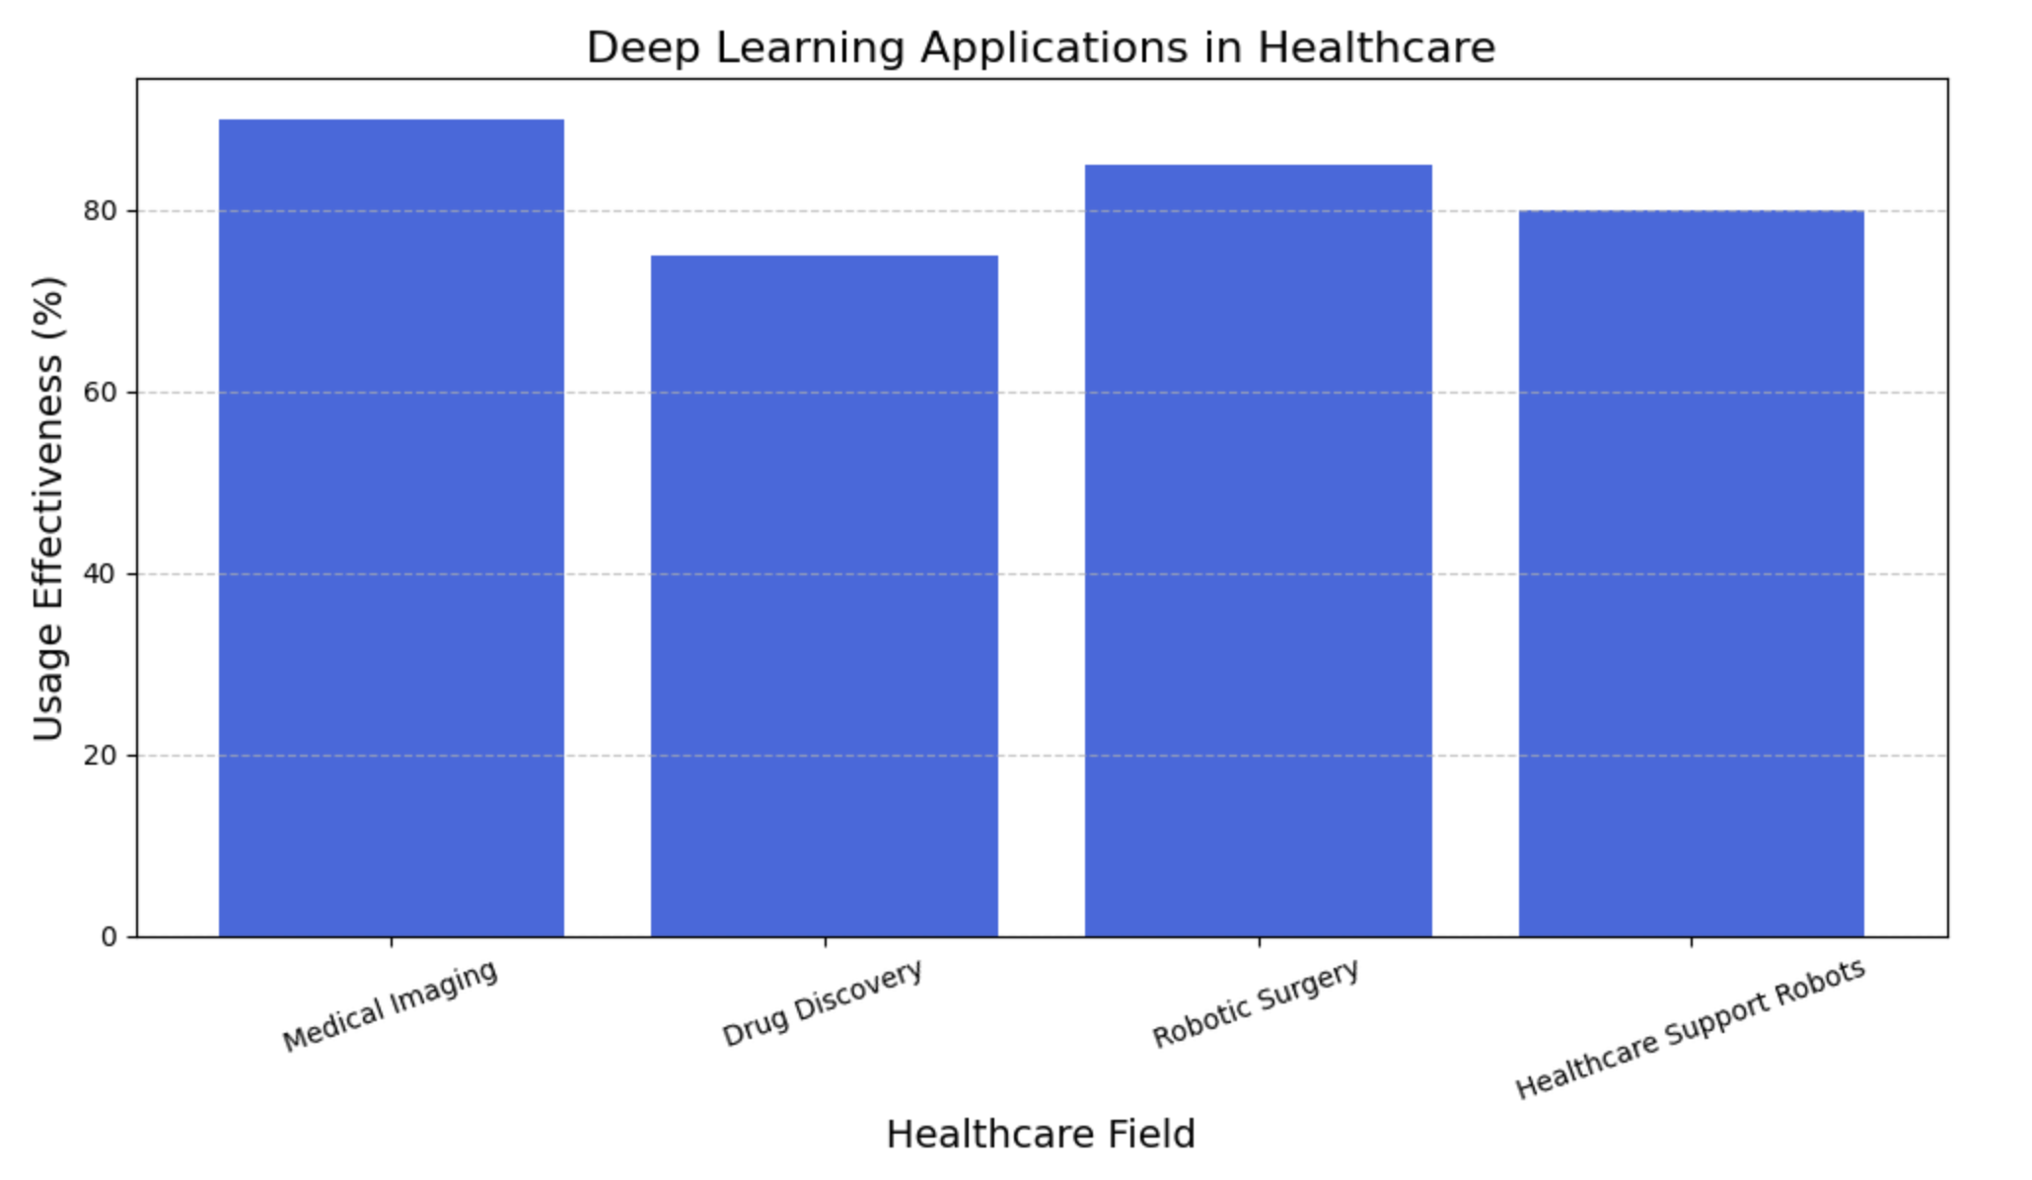
INDUSTRY APPLICATION - HEALTHCARE
AI detects diseases (cancer, fractures) via medical imaging.
Robots assist in surgeries and elderly care, reducing human exposure to risks.

Slide 6




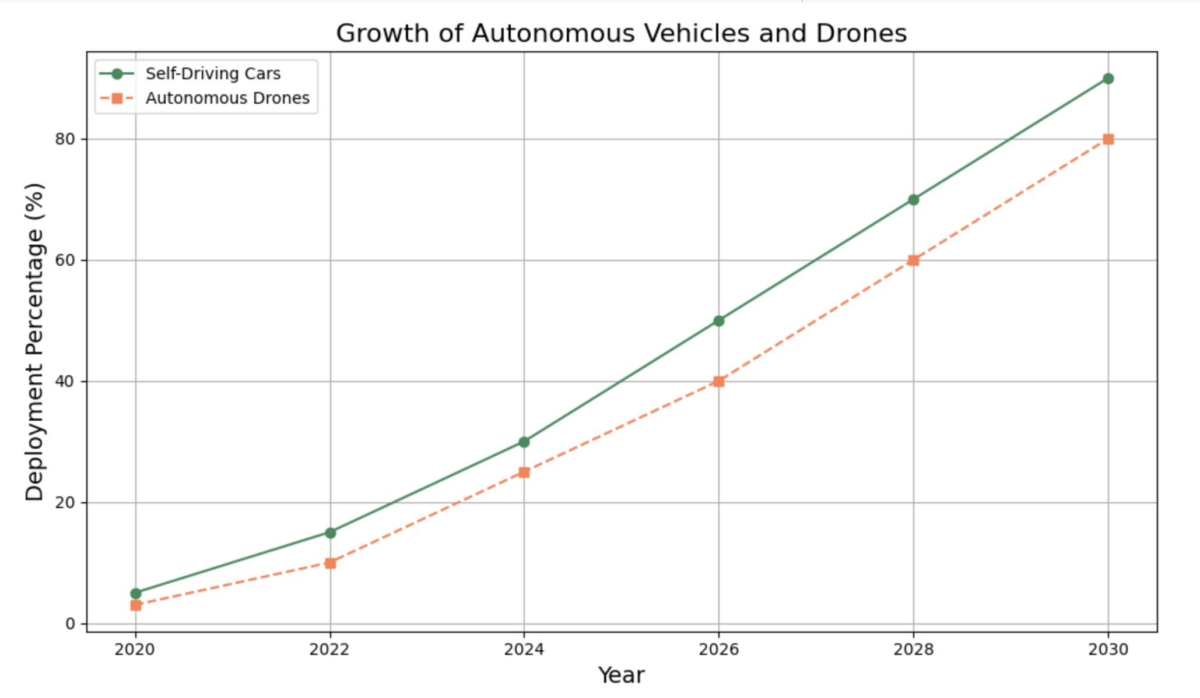





INDUSTRY APPLICATION -TRANSPORTATION
Self-driving cars and drones enhance safety and mobility.
AI predicts traffic patterns and ensures safe autonomous navigation.

Slide 7

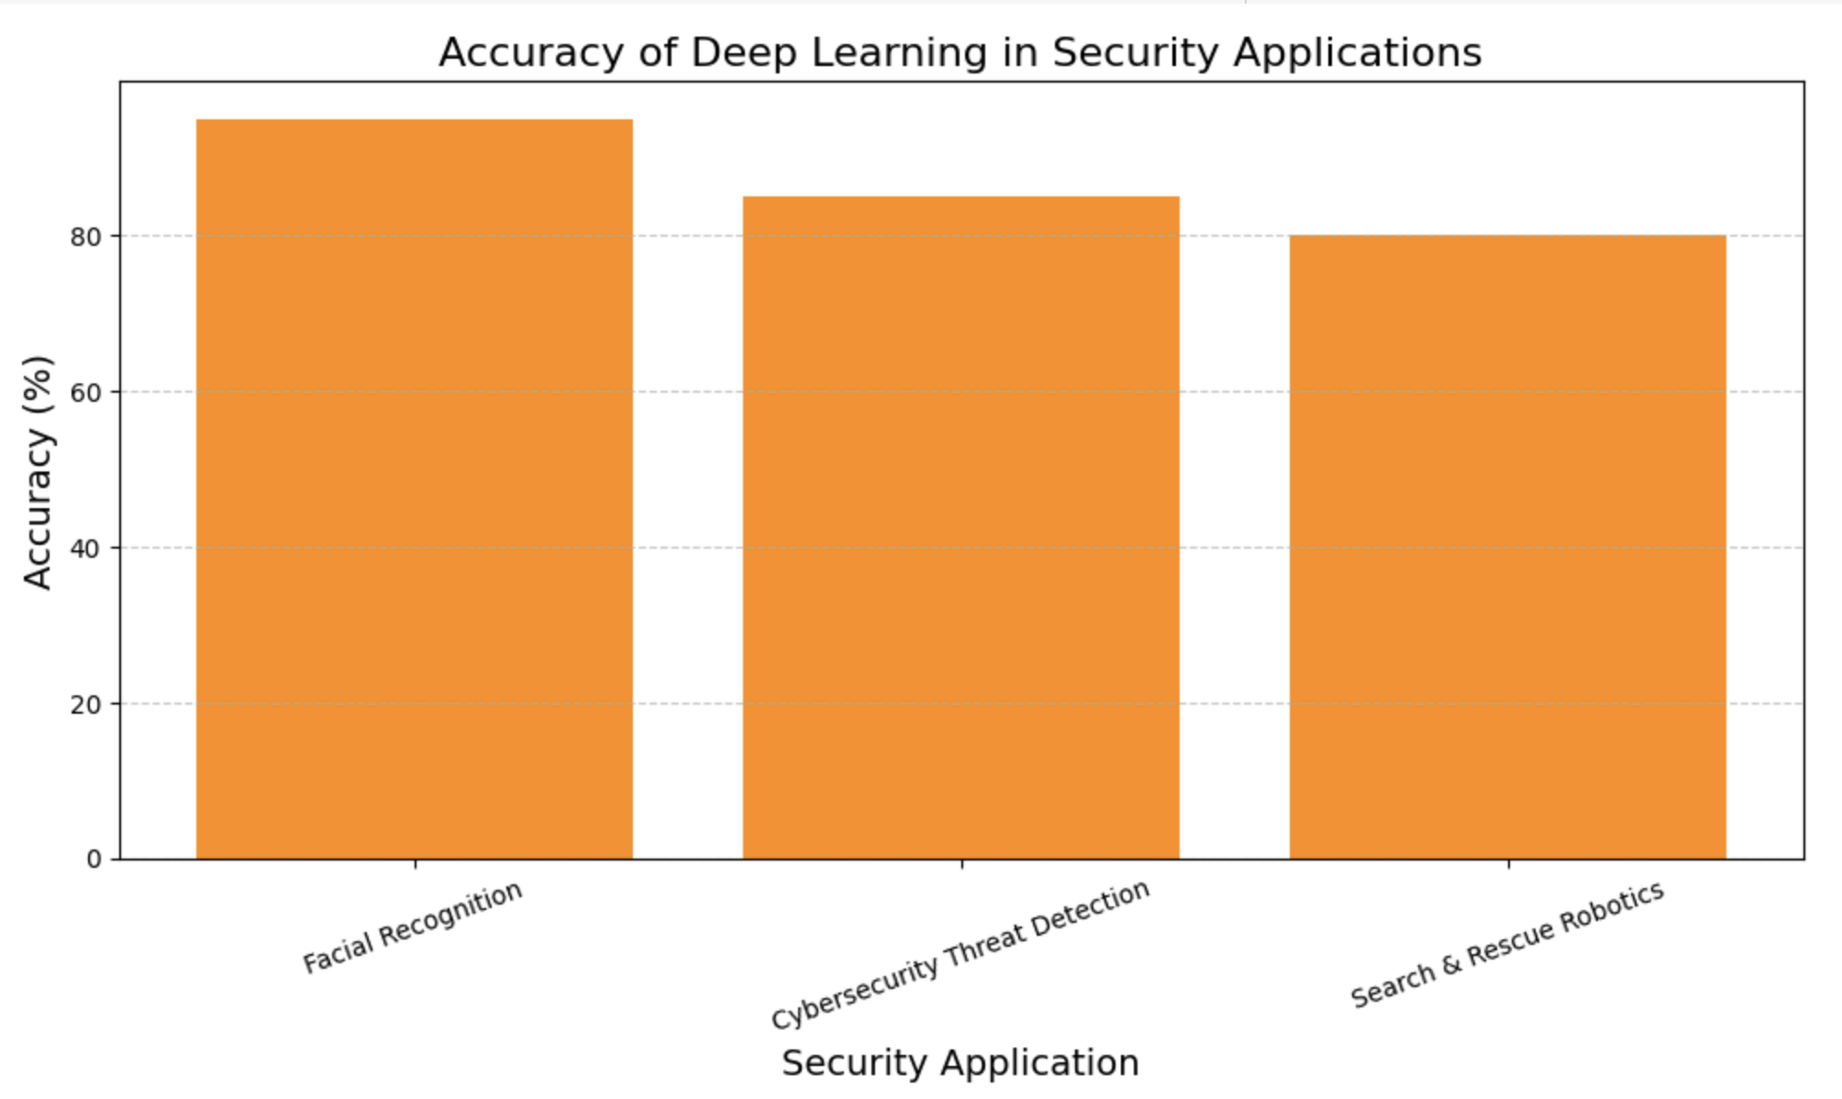
INDUSTRY APPLICATION - SECURITY
Facial recognition, cybersecurity, and search & rescue enhanced by AI.
Robots locate survivors in disaster zones.

Slide 8

FUTURE DIRECTIONS
& CHALLENGES
Technical Challenges: Energy efficiency, adaptability to harsh conditions.
Ethical Challenges: Trust, accountability, human dignity.
Future Potential: Bio-inspired robots, cloud-connected AI, human-robot collaboration.

Slide 9

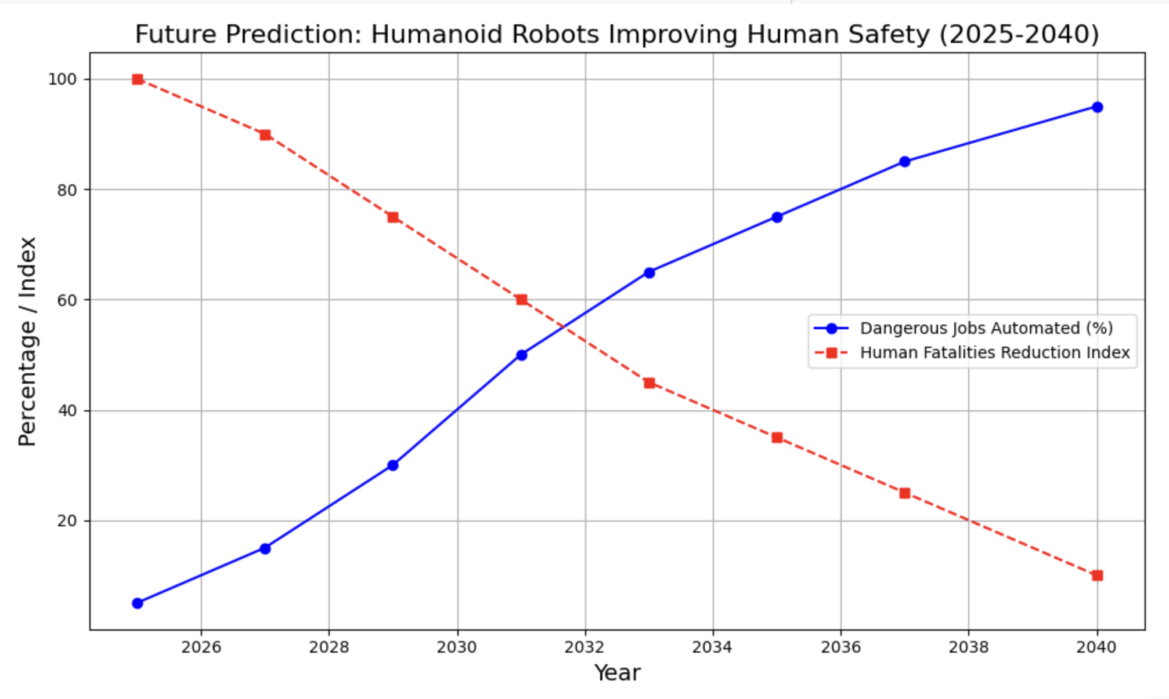
FUTURE PREDICTIONS
Deployment of humanoid robots expected to rise to 95% by 2040.
Workplace fatalities predicted to decrease by 90% due to automation.

Slide 10

CONCLUSION
Humanoid robots can transform dangerous industries.
They protect human lives without replacing meaningful human jobs.
Ethical development is critical for future success.

Slide 11


